Slide 1
DevSecOps

Slide 2
DevSecOps Target State
01
Create truly autonomous teams by combining dev, security and ops skills within the product team
Key Outcomes
02
Provide relevant and complete information to security, service delivery and application owners
DevSecOps
Legacy
Product Team
DDOS
Dev
Firewall
03
Left shift and automate adequate SDLC controls to ensure only proper functional secure applications go live
Ops
Intrusion Prevention System
Security Champion
Security Engineers
Web App Firewall
Traditional or COTS Application
Hosting Environment
04
Standardized blueprints and patterns for efficient operations and deployment
Security Architect
Security Analysts
SOC
Key Security Activities Embedded
Cloud Native
Static Code Analysis
Software Composition Analysis
Traditional applications will have more vulnerabilities where cloud native apps will have little or no security retrofitting. This impacts adoption of DevSecOps
05
Dynamic Code Scanning
Audit Records
Leverage CI/CD practices and tools to rapidly remediate (security) incidents and threats
Infrastructure Vulnerability Assessment
Security Logs & Alerts
Agile Perimeter Security Management
Agile Perimeter Security
Production Monitoring
Embedded Ops Mgmt
Penetration Testing
Cloud Native Application
06
Enforce SLA on the time to deliver a new version (e.g. remediate a critical vulnerability in 8 hrs.)
Hosting Environment with Embedded Security

Slide 3
DevSecOps Lifecycle
Support + Improve
Continuous Interventional Checks
Install IDE Plugins
Security Risk Assessment + Knowledge Sharing
Security Policy Automation + Governance + Aligned KPIs
Security Training and Coding Guidelines Distribution
Key Security Activities Embedded
Plan + Collaborate
Release + Deploy
Ideation thru Design
Architecture (Secure by Design, Secrets Mgmt, IAM, Cloud Risk Assessment)
Security Requirements
Threat Modeling
Coaching security champions
Collaboration on vulnerability remediation
Zoning & Microsegmentation
Deployment Orchestration
Change Management
Patch + Vulnerability Management
Container Security
Build + Test
Operate + Monitor
Build Automation
Continuous Integration/ Testing
Code Analysis Automation
Functional Test Automation
Static Security Analysis (SAST)
Environment Security (AV/HIPS, OS Hardening)
Data type verification, secure provisioning and protection
Access Controls
Vulnerability Correlation
Monitoring + Alerting
Incident Management
Security Event Monitoring
Security Incident Response
Security Management
Threat Management
Manual Pen Testing
Server Vulnerabilities
Continuous Integration
Continuous Delivery
Release Management
SAST + DAST Analysis
Penetration Test Automation
API Security
Data Security & Confidentiality
Notes:
Secrets management refers to the tools and methods for managing digital authentication credentials (secrets), including passwords, keys, APIs, and tokens for use in applications, services, privileged accounts and other sensitive parts of the IT ecosystem.

Slide 4
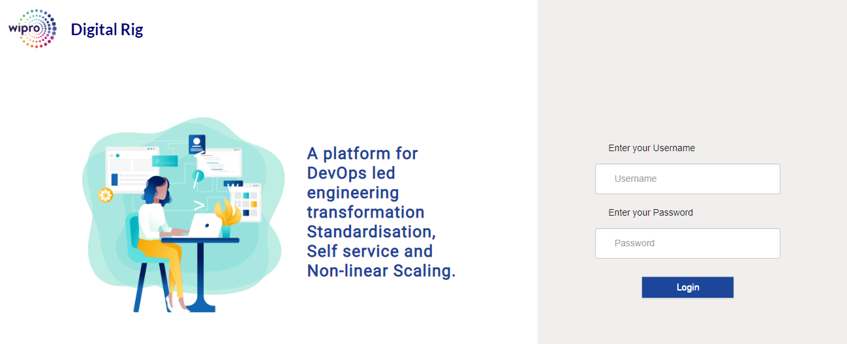
Developer Day in the Life
Security Culture
Driving security mindset – everyone is a security citizen – security is shared responsibility
Internal Branding & Continuous MarComm to drive awareness, participation and compliance
Digital Academy (security specific)
How DevOps + Security Integrate with Aligned Measures
Security Architect
Security Champion
Security Engineer
Bugfix/ Dev60
Main Branch
V1.2
Monitor + Operate
Release + Deploy
Master Branch
Test
Sprint
Backlog
Dev Branch
Development Branch
Measure Everything
IDE
Vulnerability Detected
Build
Service error rates
Response time
Patch levels/out of date alarms
Scanning results
Time to fix security issues
Security Engineer
Security Architect
Perform automated web app security assessment
Perform automated security code review
Eliminate false positives
Infra vulnerability assessment
Coordinate Security Assessment with project team
Provide remediation recommendations to devs
Develop Remediation Timeline and share it with project team
Analyze application & infrastructure security architecture and understand security threats
Network vulnerability assessment, application penetration testing and security code reviews
Draw Data Flow Diagrams (DFD), prepare threat models, identify threats and suggest mitigation steps
Perform cloud risk assessments
Identify automation avenues
Provide remediation recommendations to devs

Slide 5
Security Embedded within AMS Roadmap
WAVE 0
WAVE 1
WAVE 2
WAVE 3
DUE DILIGENCE
TRANSITION
STEADY STATE
TARGET STATE
Timeline
Pre-Contract Phase
Month 1
Month 2
Month 3
Month 4
Month 5
Month 6
Month 7
Month 8
Month 9
Month 10
Month 11
Month 12
Month 13
Month 14
Month 15
Y2
Y3
Y4
Y5
AMS Operations
Perform Transition Due Diligence
AMS Transition (Wave 1)
KEDB Improvement
RCA SWAT team
Critical Business process Monitoring
Analysis based on:
Application Complexity
Business Criticality
As-Is Process Automation
Delivery Model
Inflight Projects Phase
Support Requirements
Knowledge Acquisition
Shadow Support
Primary Support
Business Process Mining
AMS Transition (Wave 2)
AIOPS Roadmap and Implementation
Continuous optimization of app experience
AMS Transition (Wave 3)
BOTs and Daily Task Automation (HOLMES)
Technology Specific BOTs implementation (HOLMES)
Transition Office + Governance
AMS Transformation
Perform Due Diligence
Wipro Transformation team
Onboarding on ELC
Strengthen DevSecOps Platformification and Adoption
Prioritize AMS Transformation Initiatives
Establish foundation for Agile and DevSecOps Ways of Working (operational transformation)
Testing Transformation (Automation, test Data, Test Environments, etc.)
Conduct APR exercise to identify R-Lane dispositions
Application Transformation based on R-Lane Dispositions
Create Transformation Plan
Align with GTH Op Model
Product and Platform Op Model (milestones to be determined during due-diligence)
Transformation Office + Governance
Organization
Change
OCM Due Diligence
Shaping
the Change
OCM Strategy and Planning
ELC Onboarding and Cultural Alignment
Training (Agile, DevOps, Full Stack)
Driving the Change
Establish Digital Academy
Establish Product Management, Agile and DevOps Coaching capability
Define maturity, quality and delivery measures
Scaling the Change
Deliverables / Outcomes
Current state analysis and opportunity backlog for AMS
Plan for AMS transition and transformation
AMS transition (in multiple waves)
Implementation of Operational Transformation (Agile and DevSecOps Op Model)
Value Metrics Baseline
Transition and Transformation Governance
Agile and DevSecOps Ways of Working design
OCM plan
AMS transition complete
Implementation of advanced ‘Transformation’ interventions
Value metrics-based reporting and improvement
Transformation Governance
Digital Academy set-up
Products and Platform Op Model Implementation
GTH alignment
Products and Platform Op Model Implemented
GTH alignment completed
MESURABLE OUTCOME
MILESTONES

Slide 6
Key Interventions and Deliverables
Due
Diligence
Transition
Steady
State
Target
State
Perform Transition and Transformation Due Diligence
Transition work and initiate implementation of select transformation interventions
Move to Steady State of delivery. Start implementing advanced tx interventions
Align to Products and Platforms and GTH Op Model for delivery
Understand existing security standards
As-Is Process (engagement through remediation, RACI)
Security Automation
Delivery Model
Current state analysis
Plan for secure SDLC transition and transformation
Transition (in 3-waves)
Implement select transformation interventions
Establish foundation for DevSecOps, Co-create security vision
Standard Operating Procedure
Implementation of DevSecOps Op Model)
Upliftment of technology and process for known vulnerabilities
Continuous optimization security activities in SDLC
Technology Specific automation
Implementation of Transformation’ security interventions
Vulnerability correlation engine , Digital Academy
Security in-built
Products and Platform Op Model Implemented
GTH alignment completed
Security integrated in Products and Platform Op Model
Notes:
Add tentative timelines – assess 8 week
Add why do these steps below each phase or slide notes…

Slide 7
How we do it
DevSecOps Blueprints Guided by Security Standards
Application Portfolio Rationalization
Minimum Security Standards
Design DevSecOps Blueprints
BU-1
BU-2
Critical Business Process based App Prioritization
Process Impact
Regulatory Impact
Data Integrity Impact
Application Criticality | G | S | B
Threat Modelling | M | M | O
Static Security Testing | M | M | M
Dynamic Security Testing | M | M | O
Penetration Test | M | O | O
Vulnerability Scan | M | M | M
Cloud Assessments | M | M | O
BU-3
Metrics & KPIs
Resource & Schedule Mgmt.
Applications are subject to defined Threat Model that enables scoring to arrive at establishing security standards
Blended Score
Service Definitions
Multiple blue prints based on the Applications criticality
Gold
> 7 and <=10
Silver
> 4 and <=7
Based on application categorisation the security standards are determined
Enables application team to include security testing early in the SDLC life cycle
Bronze
> 0 and <=4

Slide 8
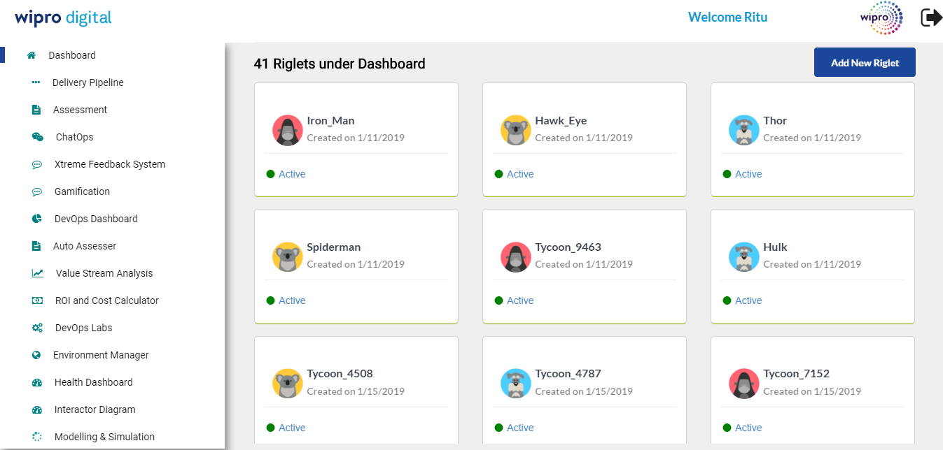
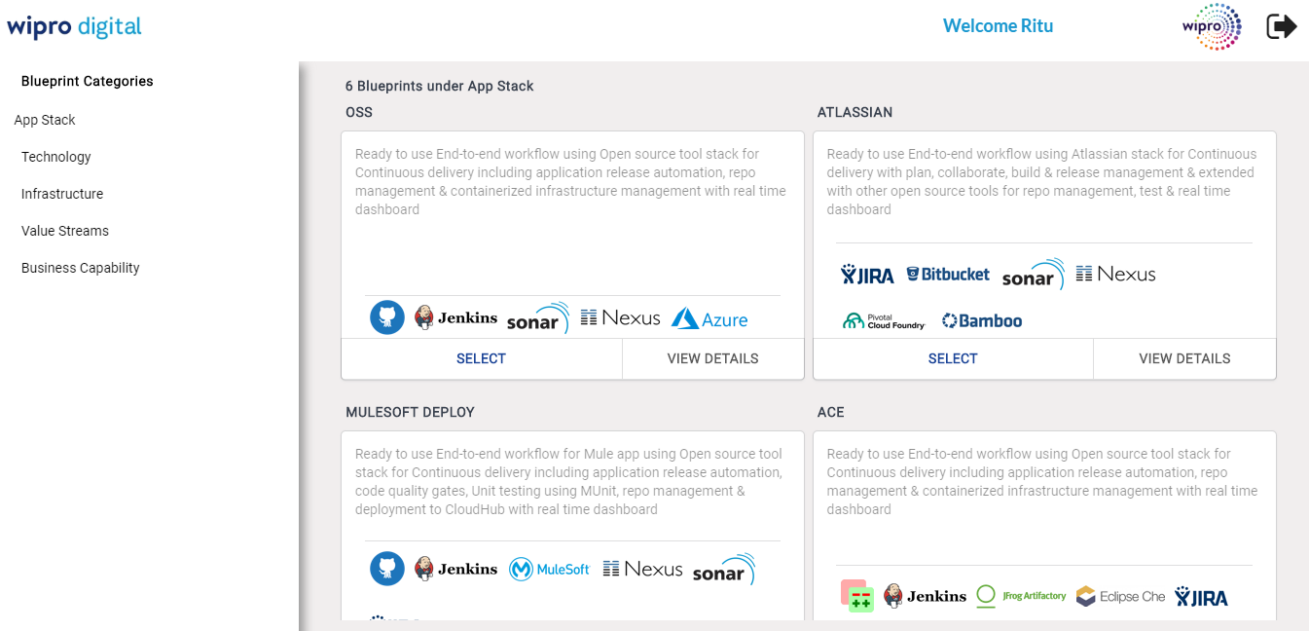
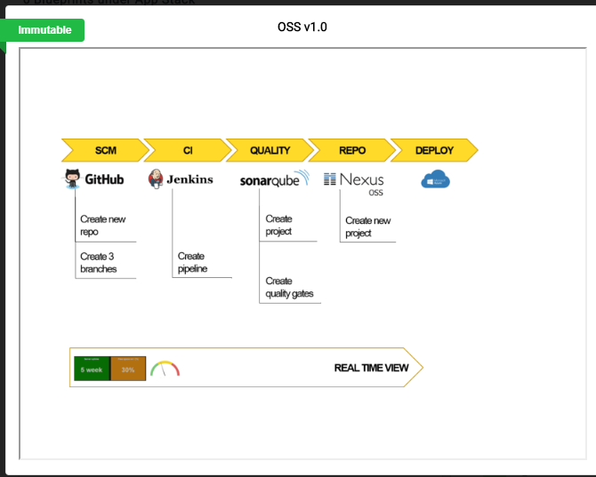
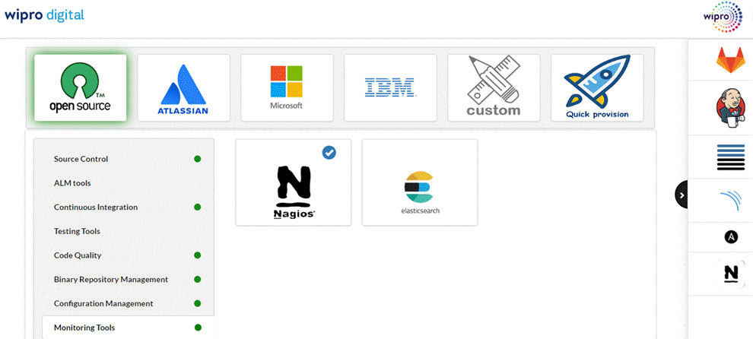
DevSecOps Console
Multiple Riglets (executable CD pipelines and blueprints) for different teams
Enterprise blueprint library for multiple archetypes, with a marketplace of tools. Self provisioned pipelines in under 10 minutes

Slide 9










The Digital Rig connects to all industry standard tools using pre-defined connectors
Lifecycle/Portfolio
Management & Collaboration
Source Code
Management
Repository
Continuous
Integration
Configuration/
Provision
Deployment
Database
Management
Build
Testing
Security
Containerization
Cloud
Logging & Analytics
Monitoring
Wipro Ventures
Sec tools
Open source tools

Slide 10
Key DevSecOps Enablers
Moving security from centralized approach to integrated dev/infra pipelines
Secure by design by default
Automated builds, tools optimization
Security in to DNA of developers
Governance
OCM: Creating Security Citizens

Slide 11
Secure by design by default
Network Layer
Platform Layer
Building perimeter / de-perimeterisation defences through a multi layered approach
Define and refine OS hardening standards, AV/HIPS
Application Layer
Data Layer
Physical Layer
Apply security design principles to build highly secure web applications via Threat Modeling
Strategy for data in rest, transit.
Trust boundaries - providing assurance of network traffic source and
destination.
Secure by Design helps you embed security controls directly into the design of solution…
Effective and Efficient Framework that can make privacy a business enabler for the organization…

Slide 12
Threat Modeling
Feature-Based
Focus on specific feature rather than entire product
Skills and Methodology remain same .
Deliverable changes in agile world.
Start the inception stage of Define phase, Creation of context level diagrams; Level 0 and Level 1 diagrams.
Enumerate threat & provide mitigation,Develop, update, and complete threat models according to tasks assigned during sprint planning.
Develop attack tree and rate risks
Mitigation steps integrate in to design document

Slide 13







Automated Builds and Testing - SAST
Stakeholders/ C-level
Risk Based Decision
Pull Code
Jenkin’s Pipeline
Trigger Static Code Scan
SCA
Upload Scan Results
Create
Defect
Code Repository
Vulnerability Assessment
Developer Checks-in code
Orchestration Engine CI/CD
Active Vulnerability status updates to developer
Security Team

Slide 14
Automated Builds and Testing - DAST
Stakeholders/ C-level
Risk Based Decision
Jenkin’s Pipeline
Trigger Static Code Scan
Web Inspect
Upload Scan Results
Create
Defect
Pull Code
Code Repository
Vulnerability Assessment
Developer Checks-in code
Orchestration Engine CI/CD
Active Vulnerability status updates to developer
Security Team

Slide 15

Unified Vulnerability Correlation Engine – A 3 Dimensional Experience
Manage security vulnerabilities
ThreadFix Workflow
IT Stakeholder experience
Insight Driven Operations: ThreadFix Analytics for real time & preventive ops
Service Model: Top down topology based model covering infrastructure to business process
Integrated POD: PODs with security SMEs aligned with business unit Remediation Tracking: enable remediation tracking application, business unit wise
End User Experience
Vulnerabilities logged as Defects: in bug tracking system
Open vulnerabilities can be added to the product backlog and remediation progress will be tracked & reported
Proactive Technical Debt Focus: ThreadFix to enable vulnerability monitoring rigorous focus on preventing defects in to production environment
Business Experience
Visibility of vulnerabilities: contribution of each business unit
Compliance reporting can be tracked on a click of a button or emailed on set frequency
Fortify & open source scanning
Reporting & Analytics
Scanner Integration
WebInsoect
Defect Trackers
Vulnerability Correlation
Infra VA
ITSM
Faster Vulnerability Rem edition
Manual Penetration Testing
GRC

Slide 16
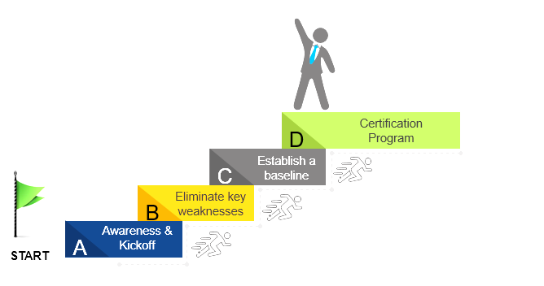
OCM: Creating Security Citizens
03 Reinforcing Learning
Internal Branding exercise
Gamified Learning
Periodic Risk Tracker
Programmatically built management reports
Developer/Organization specific programs catalogue for training
Hackathon
01 Assessments
Internal certiﬁcation program with assessment
Risk assessment
SCW could be used as a skill-testing tool in the recruitment process as well.
02 Training
Role-speciﬁc training (e.g. front-end, back-end)
Compliance-speciﬁc training (e.g. PCI-DSS, OWASP Top 10)
Employee-speciﬁc training (e.g. onboarding of new developers)
Uplifting skills and Certification programs

Slide 17
Case in Point

Slide 18
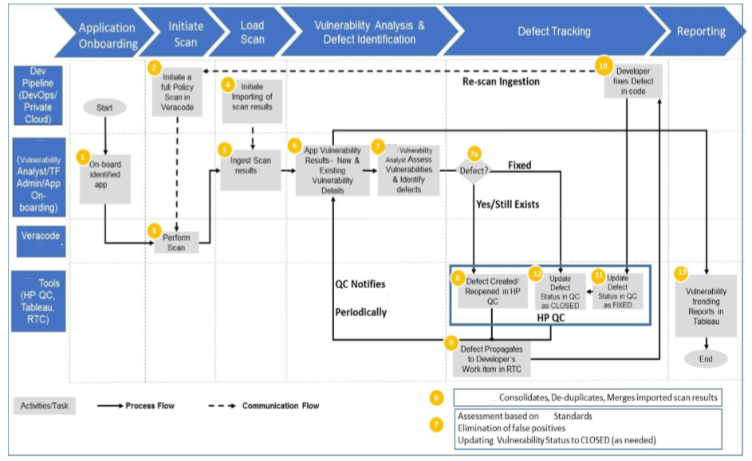
Case in point #1

Slide 19
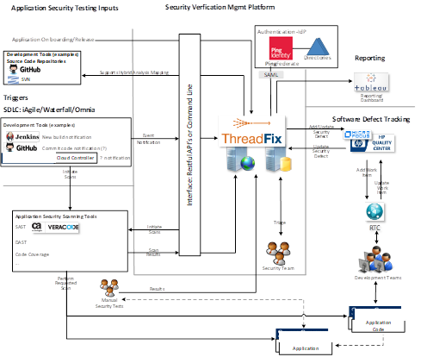
Case in point #1

Slide 20
Case in point #1
Scaling Application Security for a Major Insurance Co. in US
Business Context
Solution Approach
Business Benefits
Implement a centralized Vulnerability Discovery Management platform
Extensible to a variety of automated scanners
Integration with Development Pipelines
Integration with Defect Tracker & Reporting tool
Left Shift
Discover vulnerabilities earlier in the SDLC process by providing Static Application Testing Tools (SAST, or code/binary scanning)
Right Shift
Discover exploitable vulnerabilities during QA testing that occurs in an applications UAT environment in the SDLC process by bringing in DAST
Penetration testing results
Hold all security vulnerability results discovered
Consolidate and de-duplicate vulnerability results
Initiate the creation of defects in the defect tracker system
Provide an interface for information on application vulnerabilities
Integrate with CI/CD pipeline
Deep understanding of enterprise challenges in scaling application security and integration to enable on-time and seamless delivery.
Contextualization of the vulnerability management framework to suit the business objective of the organization.
Flexible engagement model with global talent with ability to scale and deliver high-volume requirement.
Strong partnership with cutting-edge technology companies to discover and remediate vulnerability beyond the conventional tools.
Value
Wipro Brings

Slide 21
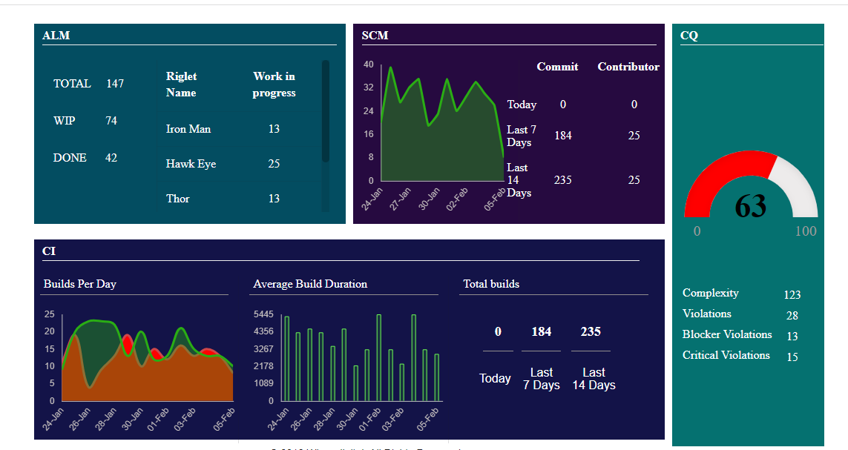
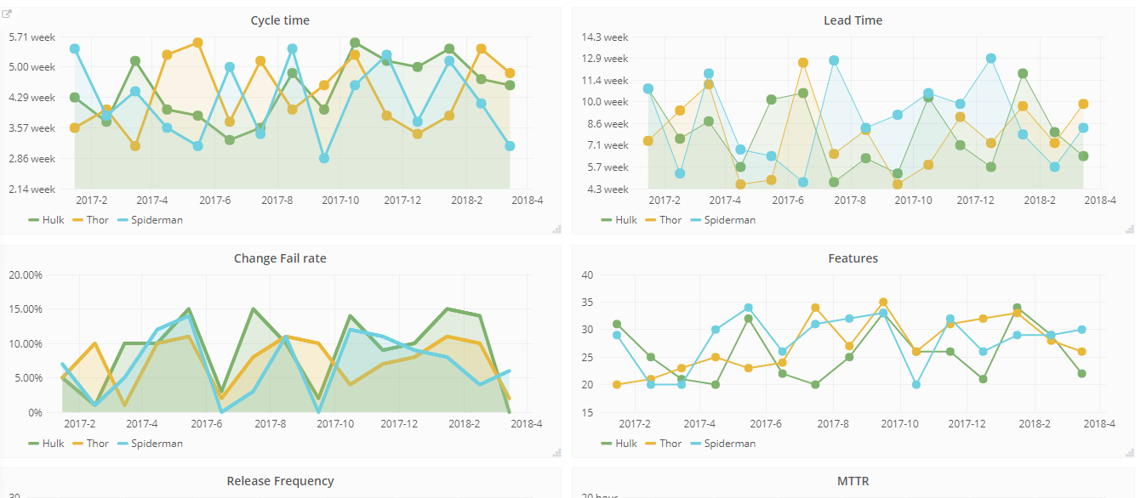
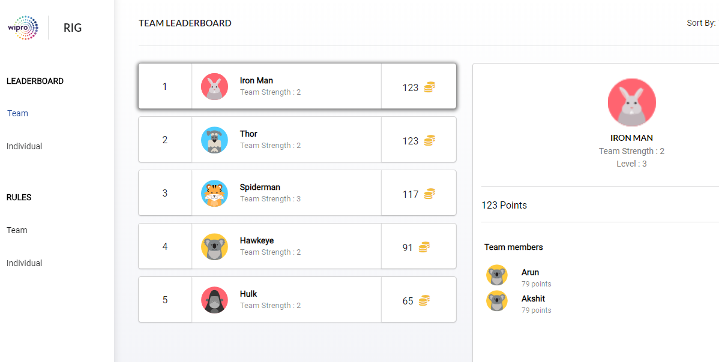
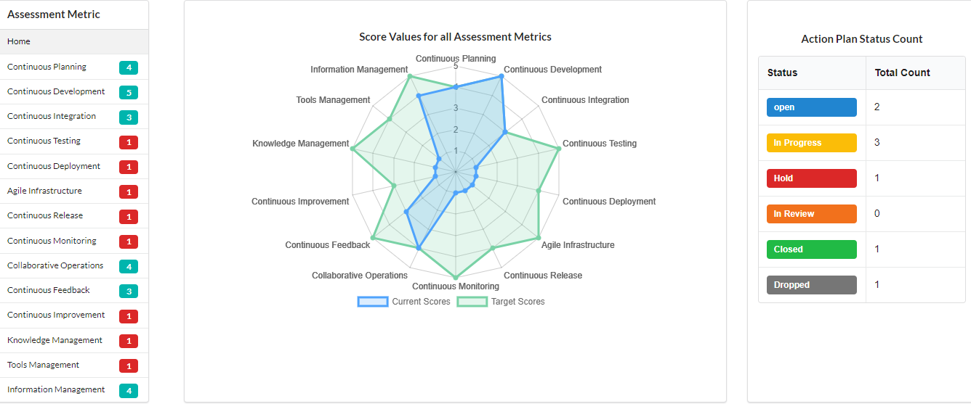
DevSecOps Console
Real Time view of metrics for engineers to assess pipeline health.
Time series based analytics view to identify patterns and events
Gamification for culture building
Self assessment and action planning for continuous improvement

